Slide 1
Demo Day Preparation
Dirk Riehle, Univ. Erlangen
AMOS B07
Licensed under CC BY 4.0 International

Slide 2
Documentation
Documentation has been initialized and is being maintained

Slide 3
The AMOS Demo Day
The demo day is the final day of the course
The demo day is organized as a fair (“Messe”)
Student teams show the results of their project
Audience are industry partners and fellow students

Slide 4
Demo Day Process
Opening (20 min.)
General introduction
1 slide, 1 min. introduction by each team (one speaker)
Demos (100 min.)
After the introduction, we split up into the different projects
One presentation booth (in-person) / demo room (online) for each project
At least one person from each project needs to be ready to demo
Demo day participants (including students without booth duty) roam around
Closing (5 min.)
We come together in the main room to say goodbye

Slide 5
Demo Day Schedule
Time | Duration | Responsible | Title | Room
10:15 | 10 min | Riehle | Introduction | Main room
10:25 | 10 min | Teams | One slide summary | Main room
10:35 | 20 min | Teams | Demo | Demo rooms
10:55 | 20 min | Teams | Demo | Demo rooms
11:15 | 20 min | Teams | Demo | Demo rooms
11:35 | 20 min | Teams | Demo | Demo rooms
11:55 | 20 min | Teams | Demo | Demo rooms
12:15 | 5 min | Riehle | Conclusions | Main room

Slide 6
In-Person Presentation Booth
You (students) are given a “presentation booth”
The booth is a table plus pinboards for posters
Please pin your posters to the pinboards and be ready to discuss them
You will demo your work in this booth
Demo your project, usually using your laptop
Explain your work using the posters
Support the demo with a slide deck
Have the demo day video ready as a backup

Slide 7
Online Demo Room
You (students) create a Zoom room from the project demos
Please create the Zoom room and share with the teachers
We will point demo day participants to your demo rooms
You will demo your work in this Zoom room
Demo your project using your laptop
Explain your work using a slide deck; should contain
One slide on product management
One slide on software development
A team photo slide (can be screenshot)
Have the demo day video ready as a backup

Slide 8
Use of Corporate Identities
Please use your university logo
Please use your team logo
Please use your industry partner logo, but ask first

Slide 9
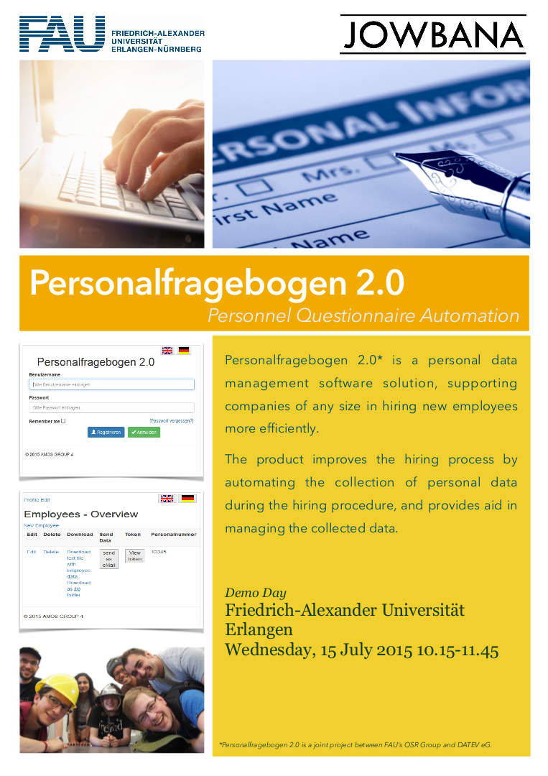
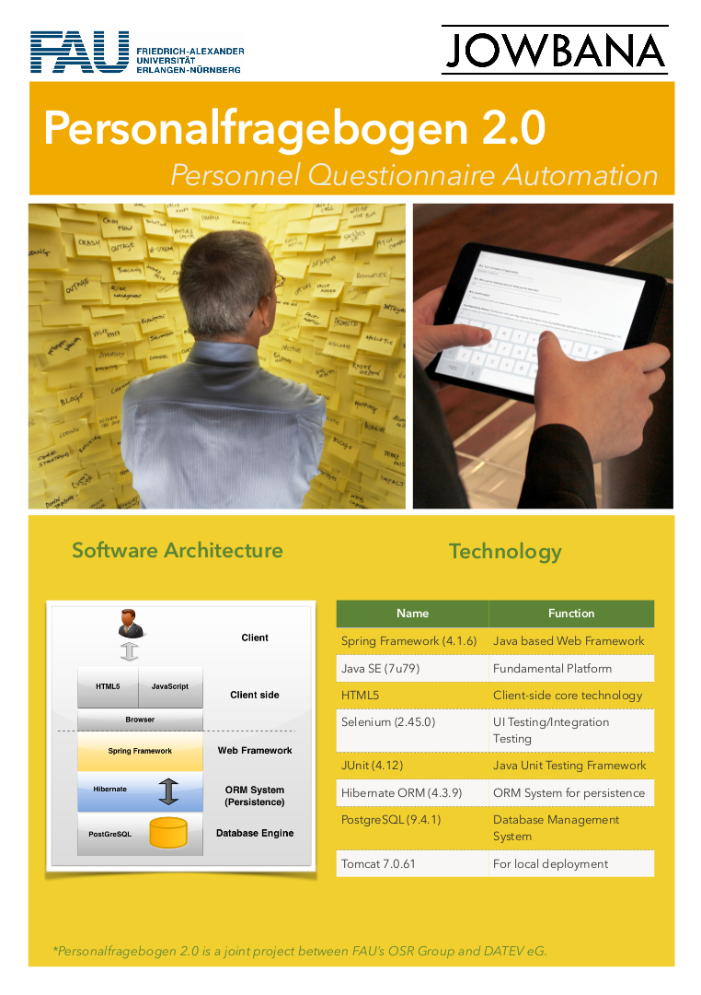
Example Posters 1 / 2

Slide 10

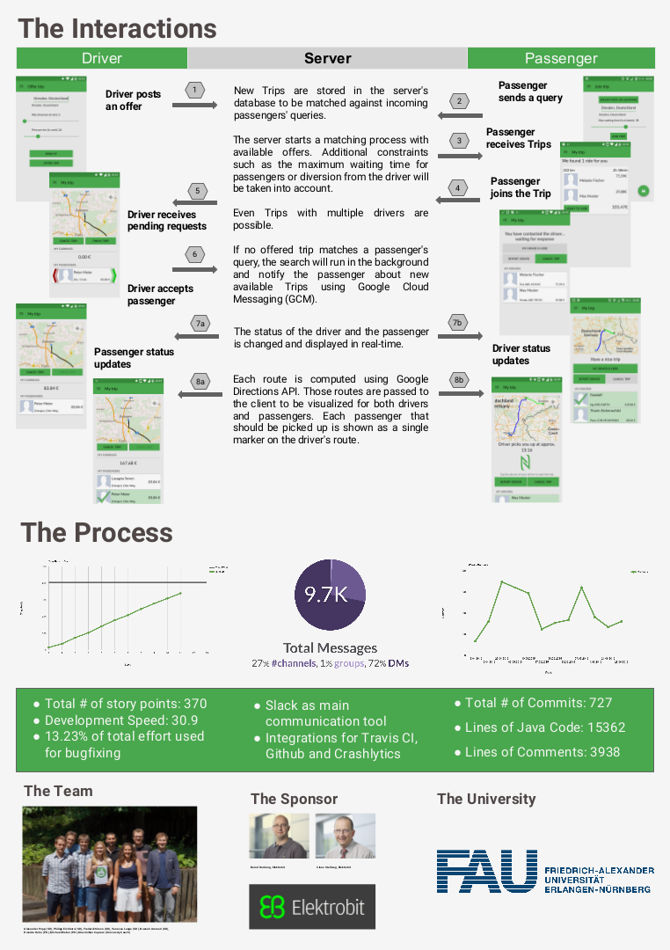
Example Posters 2 / 2

Slide 11
Twenty Minutes of Fame
At | What happens / to do
0min. | Demo room opens, participants stream in
1min. | Demo starts
10min. | Demo finishes, discussion starts
19min. | 60 second countdown to room closing starts
20min. | Room closes, everyone is pulled back into the main room

Slide 12
Demo Preparation
Dos
Have a clean user interface
Use domain terms and examples
In the user interface (labels, titles)
In the stories you tell
Have a story to tell, for example,
A day in the life of …
A workflow example
Make the demo data reentrant
You will have to start over repeatedly
You want to start at the same point
Don’ts
Use “test” or “help” as labels
Not follow the advice on the left

Slide 13
Demo Execution
Have two people ready to demo
One explains what is going on (talks to people)
One demos the software in line with story

Slide 14
Thank you! Any questions?
dirk.riehle@fau.de – https://oss.cs.fau.de
dirk@riehle.org – https://dirkriehle.com – @dirkriehle

Slide 15
Legal Notices
License
Licensed under the CC BY 4.0 International license
Copyright
© Copyright 2023 Dirk Riehle, some rights reserved

